Slide 1

Watson Assistant Labs
Lab 3:
Enhancing Your Chatbot with
Advanced Watson Assistant Features

Slide 2
Objective
Extend your chatbot to provide new functions:
Save and reuse your user’s name
Present time-dependent responses
Advise on selecting a new mobile phone contract
Watson Assistant extended functionality
Slots
System entities
Context variables
Expressions

Slide 3
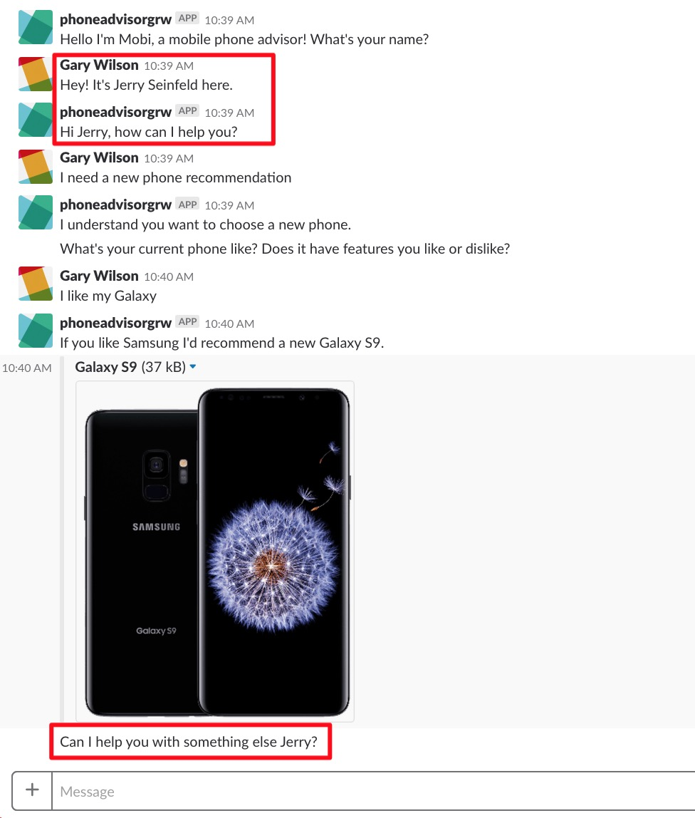
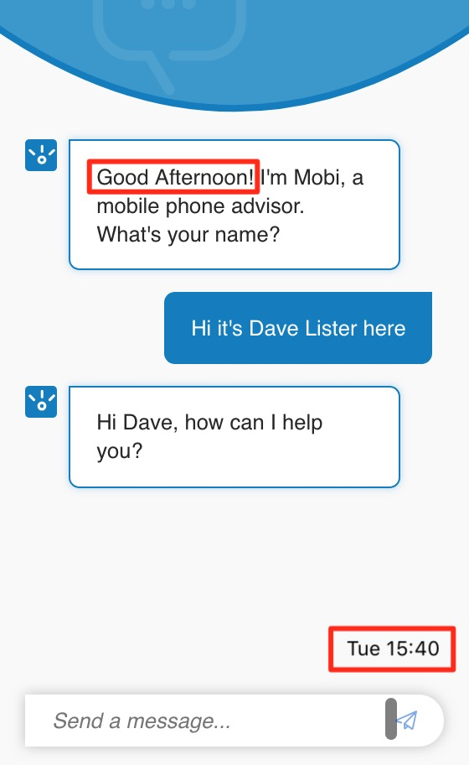
Objective

Slide 4
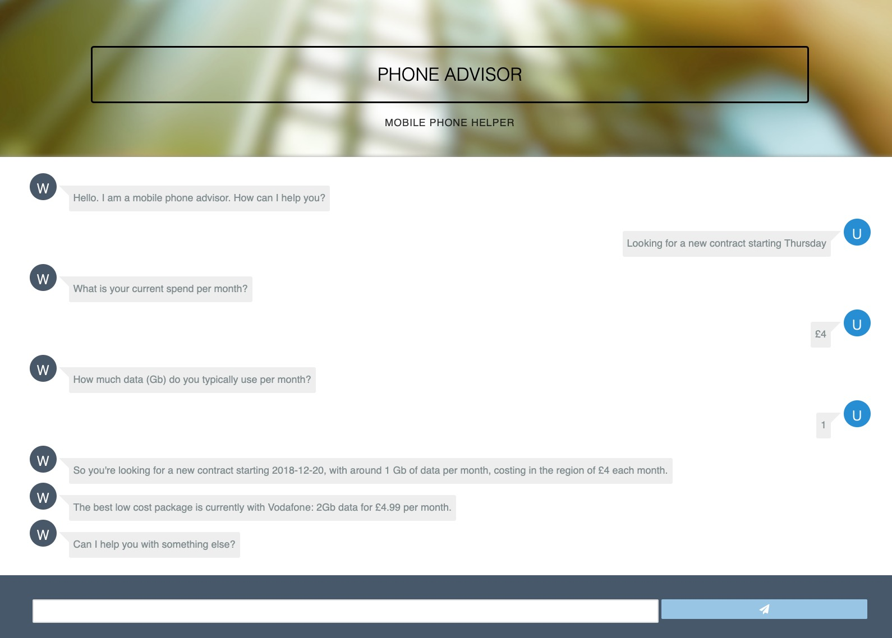
Objective

Slide 5
Agenda
Enhanced Watson Assistant functionality
extend existing dialog to cater for multiple user inputs – ‘slots’
using System Entities to capture context variables
use context variables to pass information between Watson Assistant and your Node-RED application code
add more intelligence to your responses with expressions

Slide 6
Watson Assistant: Slots
Enables developers to use prompts to gather information from users and store the information into context variables
Information to be gathered all at one time can be consolidated into one dialog node
e.g. user’s address, information needed for a reservation
Can be used to ensure dialog has all the required information and prompt the user to enter missing information
Can also be used to handle digressions while collecting information
e.g. if the user is booking a restaurant table, and when prompted to enter a time for their reservation they ask for opening times, we can give the requested information, then return to the conversation

Slide 7
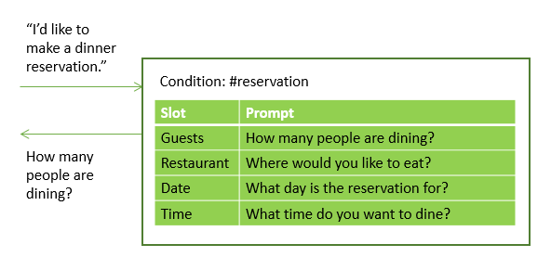
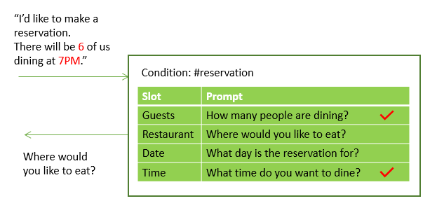
Watson Assistant: Slots

Slide 8
Watson Assistant: System Entities
System entities can be used to recognise a broad range of values for the object types they represent, for example,
@sys-number matches any numerical value, including whole numbers, decimal fractions, or even numbers written out as words
@sys-date extracts mentions such as Friday, today, or November 1, and stores the value as the corresponding inferred date as a string in the format "yyyy-MM-dd"
System entities are centrally maintained, so any updates are available automatically

Slide 9
Watson Assistant: Context Variables
Watson Assistant dialog is stateless – your application is responsible for maintaining any continuing information
But … an application can pass information to the dialog (and vice versa) using context variables
A context variable is a variable that you define in a dialog node
other nodes or application logic can subsequently set or change the value of a context variable
You can test context variables in Watson Assistant dialog node conditions to determine whether to execute a node
And you can pass and use context variables to other application logic … we’ll see this in the next few labs

Slide 10
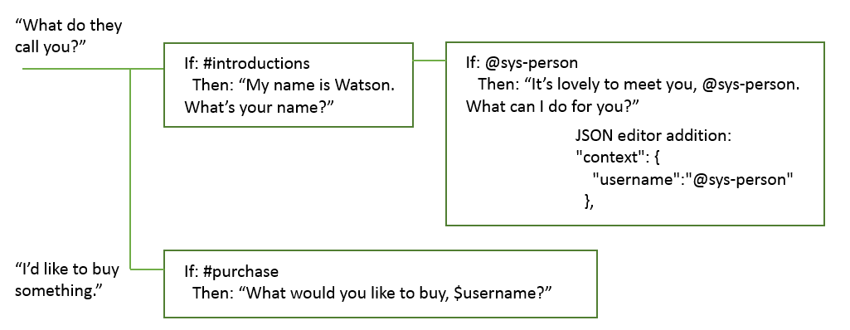
Watson Assistant: Context Variables

Slide 11
Watson Assistant: Expressions
Process values extracted from user input that you might want to reference in a context variable, condition, or elsewhere in your response
input.text: last text the user entered
input.text == 'Yes’
input.text.contains( 'Yes' )
input.text.matches( '[0-9]+’ ) … user input is a number
input.text.length() == 10 … user input contains 10 characters
@sys-time.before('12:00:00’) … time entered by user is before noon
now().after(‘18:00:00’) … current time is after 6pm
"Today's date is <? today() ?>” … get today’s date and send to user
You can write expressions that access objects and properties of objects by using the Spring Expression (SpEL) language

Slide 12
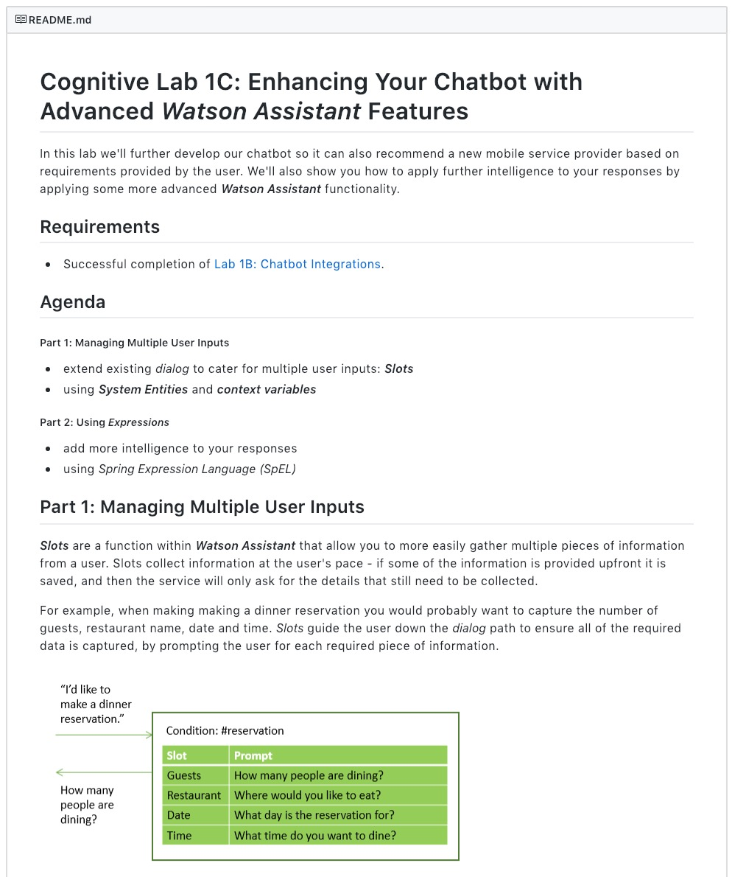
Lab Format
Step-by-step instructions
GitHub README.md for each lab
Work at your own pace
https://github.com/garyrwilson/Watson-Assistant-Labs/3-Advanced

Slide 13
Watson Assistant Labs
Lab 3:
Enhancing Your Chatbot with
Advanced Watson Assistant Features

